Slide 1


SMART INDIA HACKATHON 2025
EduMitra AI Rajasthan AI Student Assistance Chatbot
Problem Statement ID - [SIH2025-EDTECH-03] Problem Statement Title - Rajasthan AI Student Assistance Chatbot Theme - Smart Education / EdTech PS Category - Software Team ID - [Your Team ID] Team Name - Endeavours

Slide 2
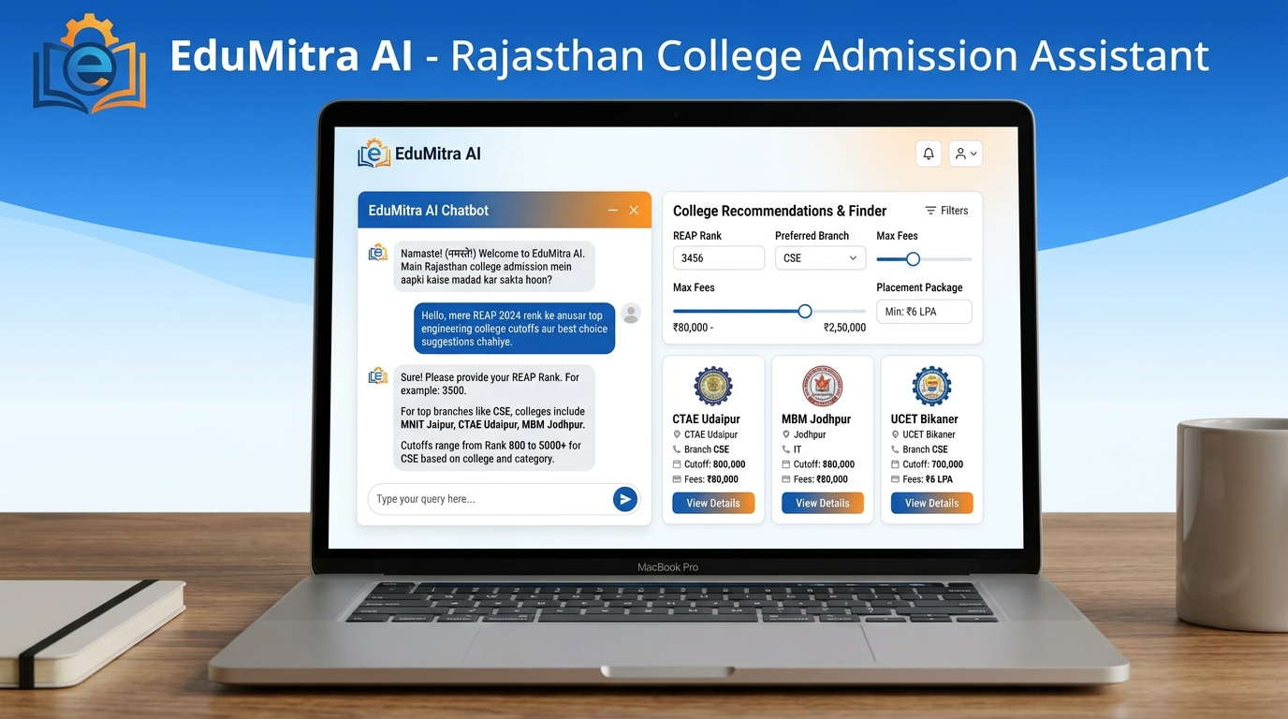
EduMitra AI - Centralized AI Student Assistant for Rajasthan Admissions â€¢ Multilingual AI Chatbot (Hindi / English / Voice): Answers natural language queries regarding REAP/DTE cutoffs, fees, hostels, eligibility and scholarships. â€¢ Smart College Recommendation Engine: Suggests optimal engineering and polytechnic colleges based on student REAP rank, category, branch, and budget. â€¢ Side-by-Side College Comparison: Evaluates institutions across placements, infrastructure, NAAC grade, and fee structures. â€¢ Scholarship and Welfare Finder: Automatically maps eligible state (CM Higher Education) and central scholarships. â€¢ 80%+ Reduction in Staff Workload: Automates repetitive admission office inquiries for all Rajasthan technical institutes.
Your Team Name
EduMitra AI - Centralized AI Student Assistant for Rajasthan Admissions â€¢ Multilingual AI Chatbot (Hindi / English / Voice): Answers natural language queries regarding REAP/DTE cutoffs, fees, hostels, eligibility and scholarships. â€¢ Smart College Recommendation Engine: Suggests optimal engineering and polytechnic colleges based on student REAP rank, category, branch, and budget. â€¢ Side-by-Side College Comparison: Evaluates institutions across placements, infrastructure, NAAC grade, and fee structures. â€¢ Scholarship and Welfare Finder: Automatically maps eligible state (CM Higher Education) and central scholarships. â€¢ 80%+ Reduction in Staff Workload: Automates repetitive admission office inquiries for all Rajasthan technical institutes.

Slide 3
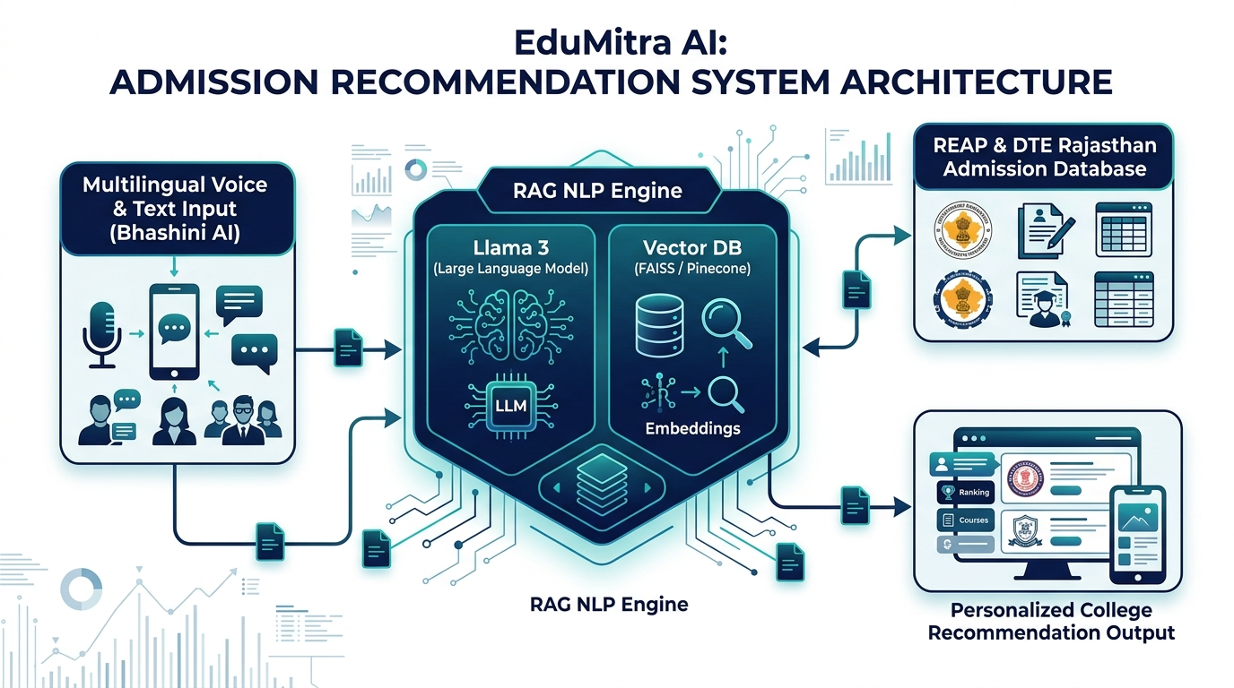
TECHNICAL APPROACH AND SYSTEM ARCHITECTURE â€¢ Multilingual NLP and Voice Core: Bhashini API + Llama 3 for real-time Hindi/English voice and text Q and A. â€¢ RAG (Retrieval-Augmented Generation): Vector DB (ChromaDB) indexing official REAP/DTE seat matrix and cutoff rulebooks. â€¢ Tech Stack: React.js (Frontend PWA), Python FastAPI (AI Microservices), Node.js (Backend Gateway), PostgreSQL (College DB). â€¢ High Accuracy and Zero Hallucination: Strict RAG grounding with source document citations.
Your Team Name
Technologies to be used (e.g. programming languages, frameworks, hardware)
Methodology and process for implementation (Flow Charts/Images/ working prototype)

Slide 4
FEASIBILITY, VIABILITY AND RISK MITIGATION FEASIBILITY AND PRACTICALITY: â€¢ High Technical Feasibility: Built on open-source Llama 3 + RAG requiring lightweight server infrastructure. â€¢ High Accessibility: Works via Web PWA and WhatsApp Bot for low-bandwidth rural access across Rajasthan. RISKS AND STRATEGIES: â€¢ Challenge: Dynamic yearly REAP cutoff and seat updates -> Strategy: Automated admin verification pipeline for DTE data. â€¢ Challenge: Rural accessibility and low digital literacy -> Strategy: Voice-based search in Hindi and regional dialects. â€¢ Challenge: Information Accuracy -> Strategy: Verified source linking to official DTE Rajasthan portals.
Your Team Name
Analysis of the feasibility of the idea
Potential challenges and risks
Strategies for overcoming these challenges

Slide 5
IMPACT, BENEFITS AND SUSTAINABILITY MODEL IMPACT AND BENEFITS: â€¢ For Students and Parents: Transparent, instant, 24/7 admission guidance without travel or middleman fees. â€¢ For Colleges and Staff: 80% decrease in repetitive inquiry calls/emails; automated query routing. â€¢ For Govt and DTE Rajasthan: Digitized student counselling; higher awareness of govt scholarships. SUSTAINABILITY AND EXPANSION: â€¢ State Adoption: Direct deployment with DTE Rajasthan and REAP counselling portal. â€¢ Scalability: Extendable to ITI, Medical (NEET), and University admissions across other Indian states.
Your Team Name
Potential impact on the target audience
Benefits of the solution (social, economic, environmental, etc.)

Slide 6
RESEARCH AND REFERENCES
Your Team Name
Details / Links of the reference and research work

